Slide 1
Deep learning in bioinformatics
Ming Wen

Slide 2
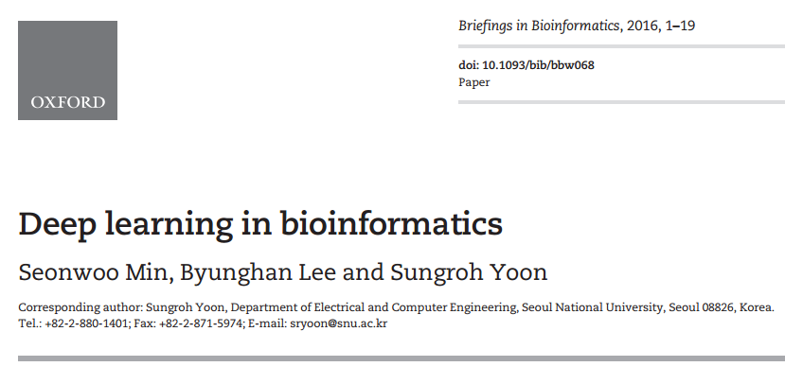

Slide 3
Contents
Introduction
Deep learning: a brief overview
Key elements of deep learning
Deep learning libraries
Deep neural networks
Convolutional neural networks
Recurrent neural networks
Emergent architectures
Omics
Deep neural networks
Convolutional neural networks
Recurrent neural networks
Emergent architectures
Biomedical imaging
4 categories
Biomedical signal processing
4 categories
Discussion
Limited and imbalanced data
Changing the black-box into the white-box
Selection of an appropriate deep learning architecture and hyperparameters
Multimodal deep learning
Accelerating deep learning
Future trends of deep learning
Conclusion

Slide 4
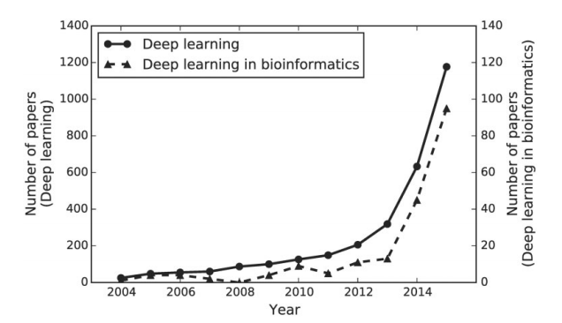
Introduction
Academic interest of Deep learning has increased rapidly since the early 2000s.
The number of articles is based on the search results on http://www.scopus.com with the two queries: ‘Deep learning,’ ‘Deep learning’ AND ‘bio*’.

Slide 5
One of the most important advancements thus far has been in image and speech recognition, although promising results have been disseminated in natural language processing and language translation.

Slide 6
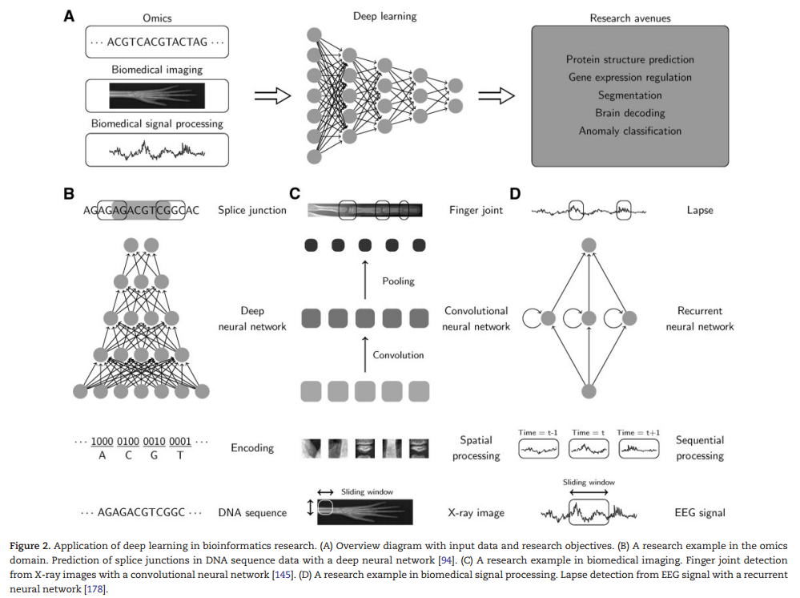

Slide 7
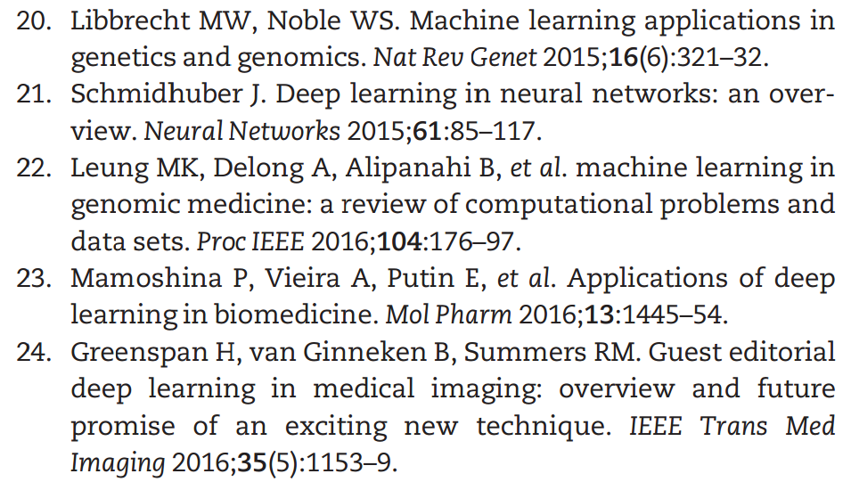
In this article, we provide a more comprehensive review of deep learning for bioinformatics and research examples categorized by bioinformatics domain and deep learning architecture.
Other reviews

Slide 8
Contents
Introduction
Deep learning: a brief overview
Key elements of deep learning
Deep learning libraries
Deep neural networks
Convolutional neural networks
Recurrent neural networks
Emergent architectures
Omics
Deep neural networks
Convolutional neural networks
Recurrent neural networks
Emergent architectures
Biomedical imaging
4 categories
Biomedical signal processing
4 categories
Discussion
Limited and imbalanced data
Changing the black-box into the white-box
Selection of an appropriate deep learning architecture and hyperparameters
Multimodal deep learning
Accelerating deep learning
Future trends of deep learning
Conclusion

Slide 9
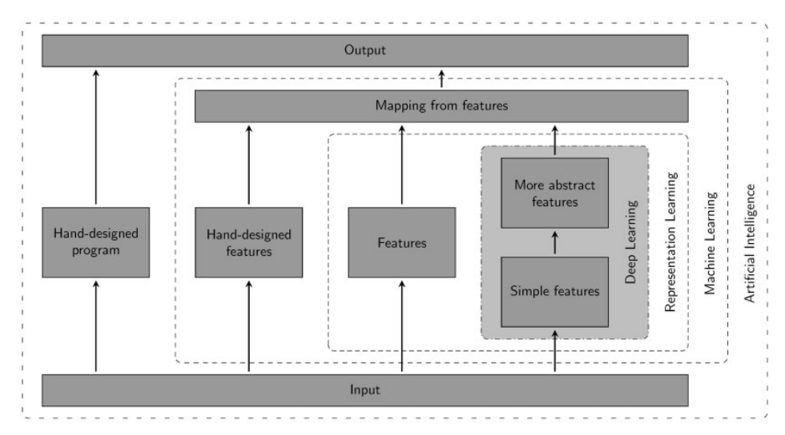
Deep learning: a brief overview
Relationships and high-level schematics of artificial intelligence, machine learning, representation learning, and deep learning.
Goodfellow I, Bengio Y, Courville A. Deep Learning. MIT Press, 2016.

Slide 10
Contents
Introduction
Deep learning: a brief overview
Key elements of deep learning
Deep learning libraries
Deep neural networks
Convolutional neural networks
Recurrent neural networks
Emergent architectures
Omics
Deep neural networks
Convolutional neural networks
Recurrent neural networks
Emergent architectures
Biomedical imaging
4 categories
Biomedical signal processing
4 categories
Discussion
Limited and imbalanced data
Changing the black-box into the white-box
Selection of an appropriate deep learning architecture and hyperparameters
Multimodal deep learning
Accelerating deep learning
Future trends of deep learning
Conclusion

Slide 11
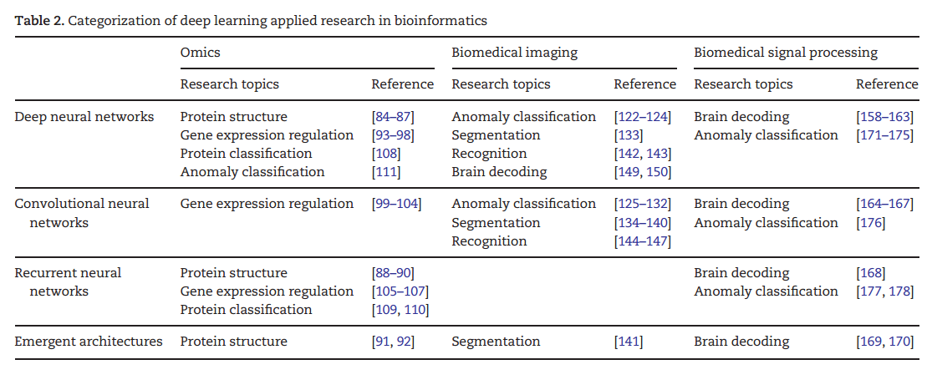
Key elements of deep learning

Slide 12
Contents
Introduction
Deep learning: a brief overview
Key elements of deep learning
Deep learning libraries
Deep neural networks
Convolutional neural networks
Recurrent neural networks
Emergent architectures
Omics
Deep neural networks
Convolutional neural networks
Recurrent neural networks
Emergent architectures
Biomedical imaging
4 categories
Biomedical signal processing
4 categories
Discussion
Limited and imbalanced data
Changing the black-box into the white-box
Selection of an appropriate deep learning architecture and hyperparameters
Multimodal deep learning
Accelerating deep learning
Future trends of deep learning
Conclusion

Slide 13
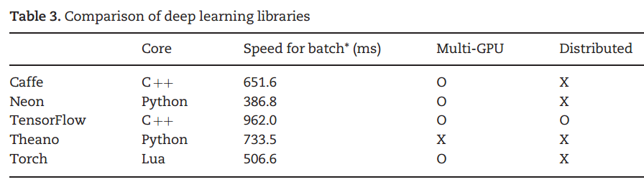
Deep learning libraries
Theano
Keras + tensorflow 1.0
Mxnet

Slide 14
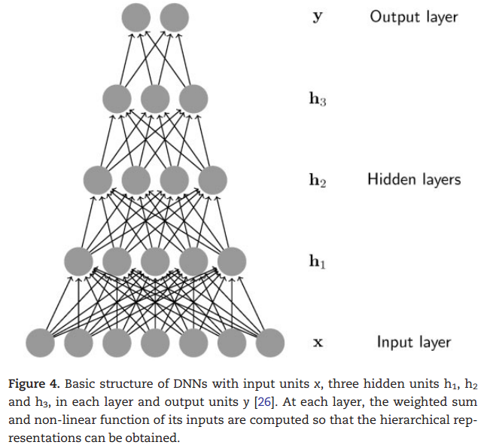
Deep neural networks
Based on the types of layers used in DNNs and the corresponding learning method, DNNs can be classified as MLP, SAE or DBN.

Slide 15
Deep neural networks
We believe that DNNs, as hierarchical representation learning methods, can discover previously unknown highly abstract patterns and correlations to provide insight to better understand the nature of the data. However, it has occurred to us that the capabilities of DNNs have not yet fully been exploited. Although the key characteristic of DNNs is that hierarchical features are learned solely from data, human designed features have often been given as inputs instead of raw data forms.
We expect that the future progress of DNNs in bioinformatics will come from investigations into proper ways to encode raw data and learn suitable features from them.

Slide 16
Contents
Introduction
Deep learning: a brief overview
Key elements of deep learning
Deep learning libraries
Deep neural networks
Convolutional neural networks
Recurrent neural networks
Emergent architectures
Omics
Deep neural networks
Convolutional neural networks
Recurrent neural networks
Emergent architectures
Biomedical imaging
4 categories
Biomedical signal processing
4 categories
Discussion
Limited and imbalanced data
Changing the black-box into the white-box
Selection of an appropriate deep learning architecture and hyperparameters
Multimodal deep learning
Accelerating deep learning
Future trends of deep learning
Conclusion

Slide 17
Convolutional neural networks
CNNs are designed to process multiple data types, especially two-dimensional images.
Currently, CNNs are one of the most successful deep learning architectures owing to their outstanding capacity to analyze spatial information.
we believe the primary research achievements in bioinformatics will come from the biomedical imaging domain. CNNs also have great potential in omics and biomedical signal processing.

Slide 18
Contents
Introduction
Deep learning: a brief overview
Key elements of deep learning
Deep learning libraries
Deep neural networks
Convolutional neural networks
Recurrent neural networks
Emergent architectures
Omics
Deep neural networks
Convolutional neural networks
Recurrent neural networks
Emergent architectures
Biomedical imaging
4 categories
Biomedical signal processing
4 categories
Discussion
Limited and imbalanced data
Changing the black-box into the white-box
Selection of an appropriate deep learning architecture and hyperparameters
Multimodal deep learning
Accelerating deep learning
Future trends of deep learning
Conclusion

Slide 19
Recurrent neural networks
RNNs, which are designed to utilize sequential information, have a basic structure with a cyclic connection。
Since there are many cases where both past and future inputs affect output for the current input (e.g. in speech recognition), bidirectional recurrent neural networks (BRNNs) have also been designed and used widely.
LSTM
DBLSTM
Since omics data and biomedical signals are typically sequential and often considered languages of nature, the capabilities of RNNs for mapping a variable-length input sequence to another sequence or fixed-size prediction are promising for bioinformatics research.

Slide 20
Contents
Introduction
Deep learning: a brief overview
Key elements of deep learning
Deep learning libraries
Deep neural networks
Convolutional neural networks
Recurrent neural networks
Emergent architectures
Omics
Deep neural networks
Convolutional neural networks
Recurrent neural networks
Emergent architectures
Biomedical imaging
4 categories
Biomedical signal processing
4 categories
Discussion
Limited and imbalanced data
Changing the black-box into the white-box
Selection of an appropriate deep learning architecture and hyperparameters
Multimodal deep learning
Accelerating deep learning
Future trends of deep learning
Conclusion

Slide 21
Emergent architectures
DST-NNs, MD-RNNs and CAEs

Slide 22
Contents
Introduction
Deep learning: a brief overview
Key elements of deep learning
Deep learning libraries
Deep neural networks
Convolutional neural networks
Recurrent neural networks
Emergent architectures
Omics
Deep neural networks
Convolutional neural networks
Recurrent neural networks
Emergent architectures
Biomedical imaging
4 categories
Biomedical signal processing
4 categories
Discussion
Limited and imbalanced data
Changing the black-box into the white-box
Selection of an appropriate deep learning architecture and hyperparameters
Multimodal deep learning
Accelerating deep learning
Future trends of deep learning
Conclusion

Slide 23
Omics
In omics research, genetic information such as genome, transcriptome and proteome data is used to approach problems in bioinformatics. Some of the most common input data in omics are raw biological sequences (i.e. DNA, RNA, amino acid sequences) which have become relatively affordable and easy to obtain with next generation sequencing technology.

Slide 24
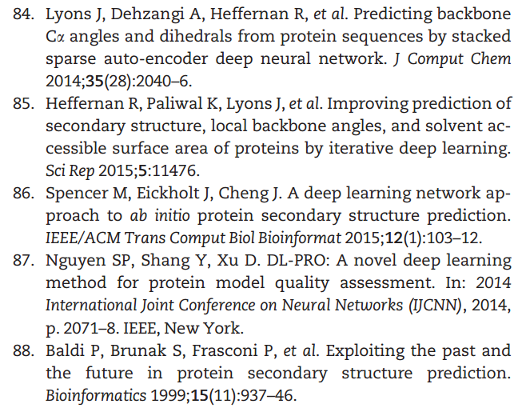
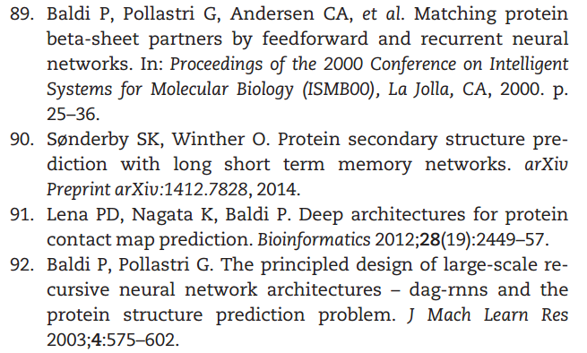

Slide 25
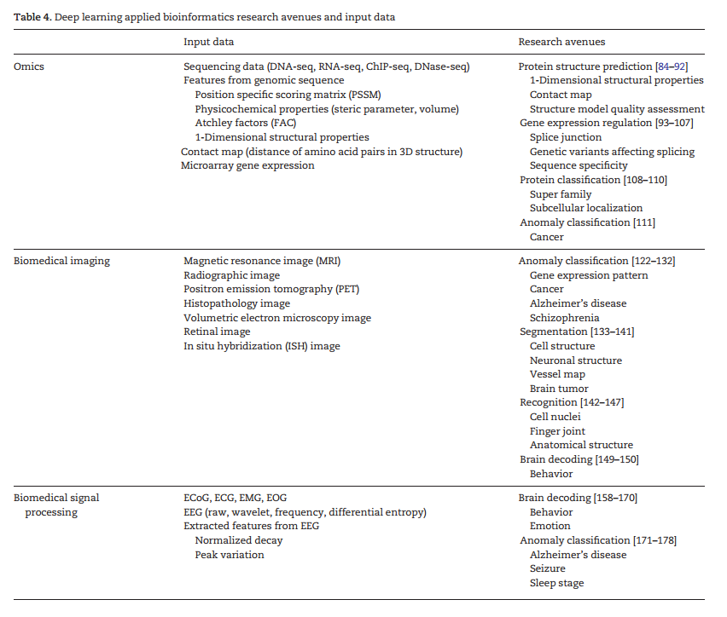

Slide 26
Contents
Introduction
Deep learning: a brief overview
Key elements of deep learning
Deep learning libraries
Deep neural networks
Convolutional neural networks
Recurrent neural networks
Emergent architectures
Omics
Deep neural networks
Convolutional neural networks
Recurrent neural networks
Emergent architectures
Biomedical imaging
4 categories
Biomedical signal processing
4 categories
Discussion
Limited and imbalanced data
Changing the black-box into the white-box
Selection of an appropriate deep learning architecture and hyperparameters
Multimodal deep learning
Accelerating deep learning
Future trends of deep learning
Conclusion

Slide 27
Discussion
Limited and imbalanced data
Solutions to limited and imbalanced data can be divided into three major groups: data preprocessing, cost-sensitive learning and algorithmic modification.
Changing the black-box into the white-box
Selection of an appropriate deep learning architecture and hyperparameters
Multimodal deep learning
Multimodal deep learning [200], which exploits information from multiple input sources, is a promising avenue for the future of deep learning research.
Accelerating deep learning
Approaches to accelerating deep learning can be divided into three groups: advanced optimization algorithms, parallel and distributed computing and specialized hardware. To this end, some widely employed algorithms include Adagrad, Adam, batch normalization and Hessian-free optimization.

Slide 28
Discussion
Future trends of deep learning
Incorporation of traditional deep learning architectures is a promising future trend.
A few studies toward augmenting the structures of RNNs have been conducted as well. Neural Turing machines and memory networks have adopted addressable external memory in RNNs and shown great results for tasks requiring intricate inferences.
Recently, adversarial examples, which degrade performance with small human imperceptible perturbations, have received increased attention from the machine learning community. Such as adversarial generative networks and manifold regularized networks.
In terms of learning methodology, semi-supervised learning and reinforcement learning are also receiving attention.

Slide 29
Contents
Introduction
Deep learning: a brief overview
Key elements of deep learning
Deep learning libraries
Deep neural networks
Convolutional neural networks
Recurrent neural networks
Emergent architectures
Omics
Deep neural networks
Convolutional neural networks
Recurrent neural networks
Emergent architectures
Biomedical imaging
4 categories
Biomedical signal processing
4 categories
Discussion
Limited and imbalanced data
Changing the black-box into the white-box
Selection of an appropriate deep learning architecture and hyperparameters
Multimodal deep learning
Accelerating deep learning
Future trends of deep learning
Conclusion

Slide 30
Conclusion
We believe that this review will provide valuable insight and serve as a starting point for application of deep learning to advance bioinformatics in future research.

